Slide 1
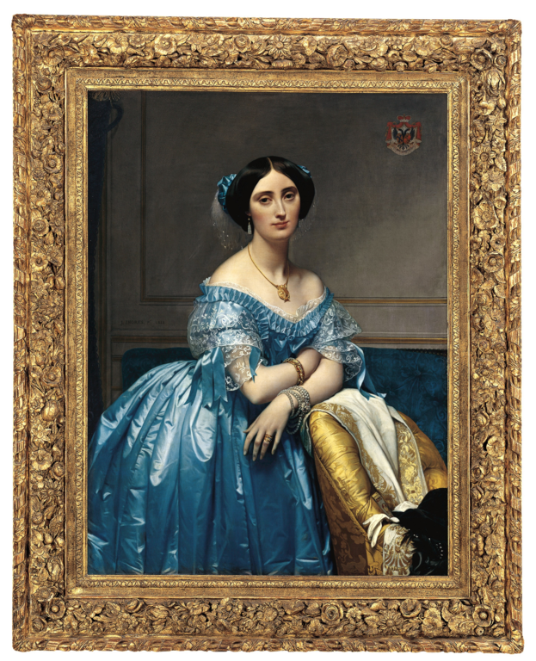
Escape Game
GREECE

Slide 2
HA-HA! I’ve caught you now!
You are trapped in a room. To get out you need to solve my puzzles and find the password!
Click on different items to get your tasks!
Click to begin

Slide 4
You have a bar of chocolate. You give ½ of it to your sister and ¼ of it to your friend. You keep the rest of it for yourself. Who has got the most of the chocolate?
You
Your sister
Your friend

Slide 5
The first letter of the password is S.
Next

Slide 7
There are 25 students in a class. One fifth of them is absent. How many students are at school?
15
18
20

Slide 8
The second letter of the password is T.
Next

Slide 10
Nikos and his four friends shared 6 apples. What part of the apples did each child get?
6/5
6/4
5/6

Slide 11
The third letter of the password is A.
Next

Slide 13
George is reading a book with 75 pages. He has read ⅔ of it. How many pages does he need to read to finish it?
25
20
15

Slide 14
The fourth letter of the password is R.
Next

Slide 15
The right password is…
stare
star
rest

Slide 16
Click on the door and get out!

Slide 17
CONGRATULATIONS!!!

Slide 18
TRY AGAIN!

Slide 19
TRY AGAIN!

Slide 20
TRY AGAIN!

Slide 21
TRY AGAIN!

Slide 22
TRY AGAIN!

Slide 23
Project: Maths is Fine with Digital Style
Project number: 2021-1-CZ01-KA220-SCH-000027773
The European Commission's support for the production of this publication does not constitute an endorsement of the contents, which reflect the views only of the authors, and the Commission cannot be held responsible for any use which may be made of the information contained therein.

